Slide 1



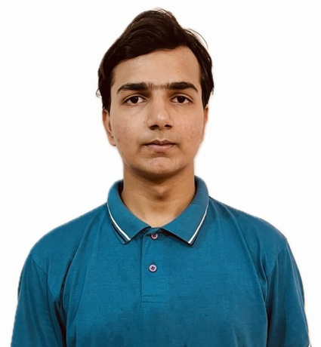



Amazon ML Challenge Finale
00_Team_Rocket
Angadjeet Singh
Parth Rastogi
Abhishek Jha
Harsh Kumar
IIIT Delhi
IIIT Delhi
IIIT Delhi
IIIT Delhi
Amazon ML Challenge Finale

Slide 2
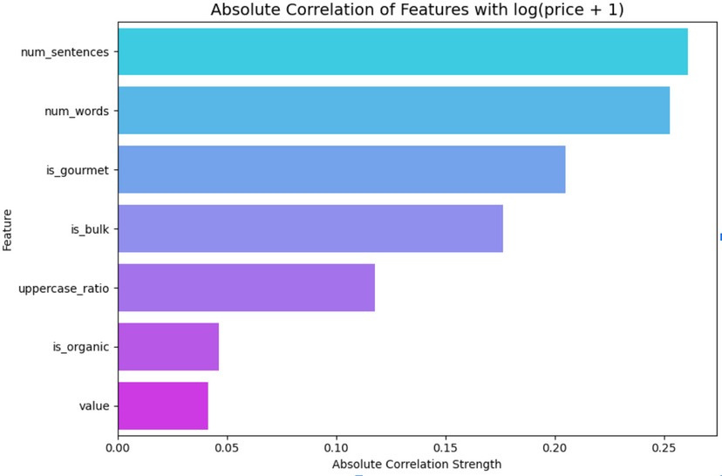
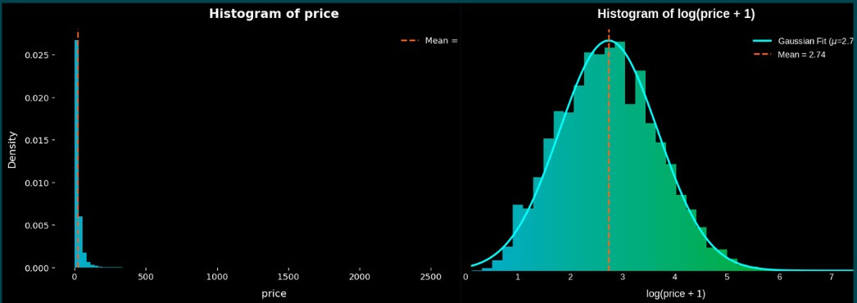


Exploratory Data Analysis (EDA)
Product prices follow a log-normal distribution, with most products clustered at lower values and few high- value outliers. Applying log(price + 1) transformation stabilizes variance and aligns with Gibrat’s Law of Proportionate Effect, facilitating model optimization.
Textual Signals: Word count, sentence structure, special characters, and phrasing provide predictive information about product quality.

Slide 3

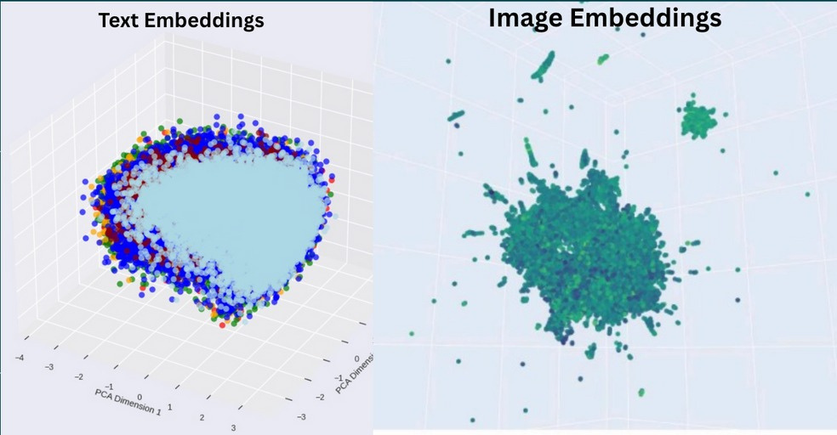


Exploratory Data Analysis (EDA)
Text Embedding extracted using Bert Analysis showed that embeddings sharing a common space have similar price, while Image Embeddings with same space have no common price range.
Image Analysis: CLIP embeddings produced similar vectors for drastically different prices, introducing noise. Conclusion: Image data has more noise than Text data .

Slide 4


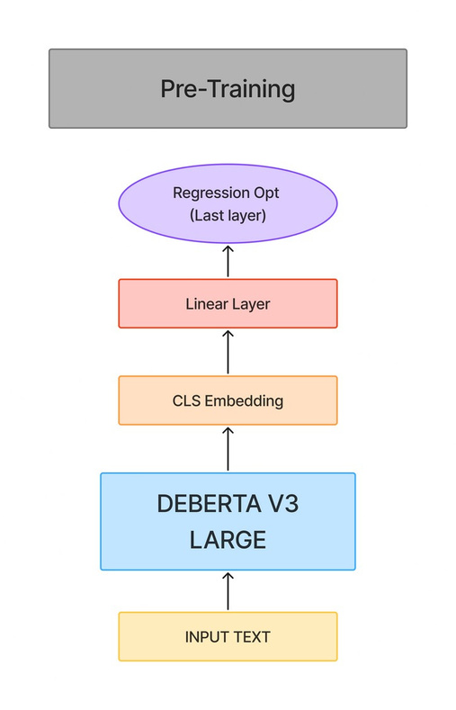
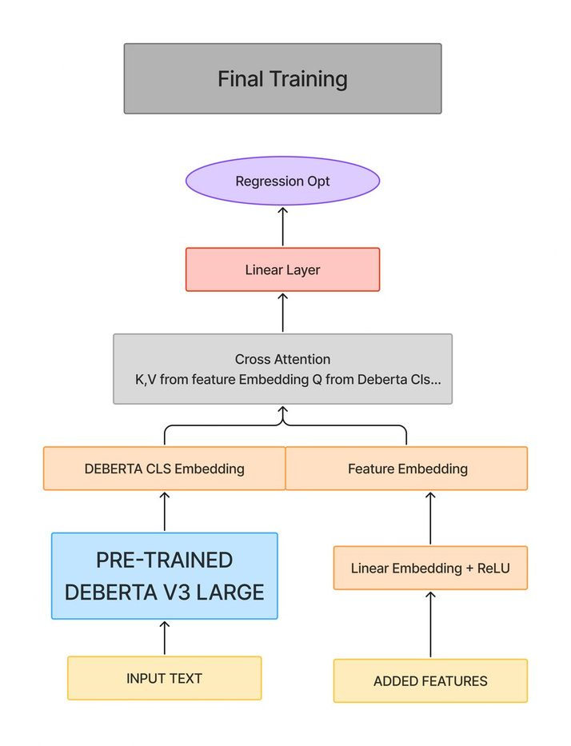
Proposed Solution Architecture
Two-Stage Hybrid Modeling Framework (441.6M parameters)
Stage 1 – Text-only Pretraining: DeBERTa- large-v3 with a linear regression head was trained on 95% of the data to predict log(price + 1). Smooth L1 loss was used to improve SMAPE stability, achieving 43.4% validation SMAPE.
Stage 2 – Feature Fusion via Cross-Attention: Handcrafted features (128-dim embeddings) were fused withPretrained DeBERTa [CLS] embeddings using cross-attention, with text as the query and features as key/value. Training for 60 epochs with Smooth L1 loss improved SMAPE to 39.83%.
Novel Aspects:
Log-transformed regression target for stable learning Smooth L1 loss optimized for SMAPE Cross-attention effectively fuses text and structured features Pretrained DeBERTa repurposed for regression
Engineered Features:
Binary: is_organic, is_gourmet, is_gluten_free, is_bulk Numeric: value, num_words, num_sentences, uppercase_ratio

Slide 5



Experiments & Comparative Results
Model Configuration
Loss Function
Additional Techniques
Hold-out
Epochs
Final Score
Transformer Models (Fine-tuned)
BERT + Linear BERT + Linear DeBERTa + Linear
DeBERTa (Frozen) + Linear DeBERTa + Linear
DeBERTa + Linear
MSE Smooth L1 MSE
Differentiable
– – –
– –
+ Pseudo-Labeling
+ Added Features + Cross-
Attention
20% 20% 5%
5% 5%
5%
3 5 30
30 30
30
49.1 48.3 45
45.6 43.4
42.8
Model Performance and Ablation
DeBERTa-large-v3 consistently outperformed BERT and traditional ML approaches. Smooth L1 loss improved convergence and stability compared to MSE. Hybrid cross-attention fusion provided a +3.6% SMAPE improvement over Stage 1 pretraining.
Smooth L1
Smooth L1
DeBERTa + Linear
Smooth L1
5%
50
39.83
Gradient Boosting Models
XGBoost
CatBoost
RMSE
RMSE
Sparse Feature Set Sparse Feature Set
5%1500 iters 5%1500 iters
55.8 54.8
All transformer models were fine-tuned using Hugging Face Transformers with the AdamW optimizer, linear learning rate decay, and a 6% warmup. Training used a sequence length of 128, a batch size of 32, a learning rate of 2e-5. As baselines, XGBoost and CatBoost were applied to sparse features, each trained for 1,500 iterations.
Observation: Traditional ML models underperform for text-heavy regression tasks.

Slide 6





Conclusion and Future Work
Scalability:
Critical Observations
Full training requires < 3 H100 GPU hours, making it efficient and cost-effective. Modular pipeline supports plug-and-play features for real-world deployment.
Feature Engineering & Cross-Attention: Handcrafted features fused with text embeddings captured key interactions. Target Transformation: Log(price + 1) stabilized variance and supported smoother optimization. Loss Function: Smooth L1 loss reduced SMAPE volatility relative to MSE.
Future Directions:
Core Learnings:
Confidence-weighted pseudo-labeling using dropout variance to leverage unlabeled data. Multi-modal cross-attention to integrate CLIP image embeddings with text. Ensemble modeling combining multiple transformer architectures for diverse semantic capture. Hyperparameter optimization using Optuna for systematic tuning.
Occam’s Razor: Simple, well-designed models outperform more complex alternatives. EDA is critical: Log-normal price distribution guided preprocessing and model design saved extensive debugging. Model repurposing works: Pretraining fine-tuned effectively for downstream regression tasks. Handcrafted features with cross-attention fusion significantly improved SMAPE.
“Our hybrid DeBERTa + Cross-Attention model demonstrates that combining domain understanding with structured feature fusion can outperform pure language models, providing a practical path to scalable ML pricing systems.”

